Slide 1
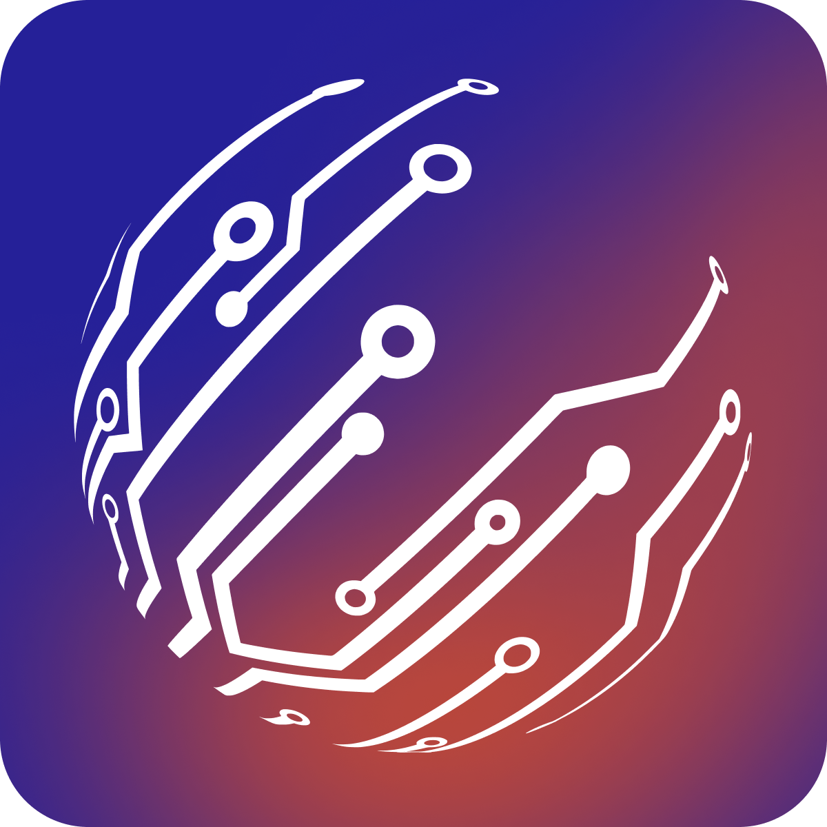
Cortance
A marketplace with an AI-Powered Expert Matching System that matches professionally vetted developers to create or scale a project development team.

Slide 2
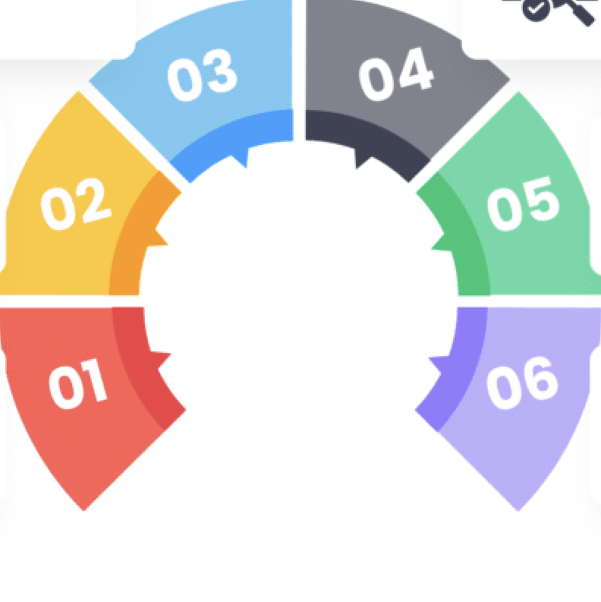
Problem
Traditional developer search requires:
Switching between vendors to find the right candidate (No existing centralised platform);
Manual form filling with dozens of fields (if there is a request form or platform);
Understanding complex filter combinations (if there is a searching platform);
Multiple iterations to refine searches;
Time-consuming proposal receiving.

Slide 3

Solution
AI-Powered Expert Matching System
Accepts natural language input;
Automatically generates structured filters;
Returns precise matches instantly;
Streamlines proposal creation;
Proposes following actions;

Slide 4
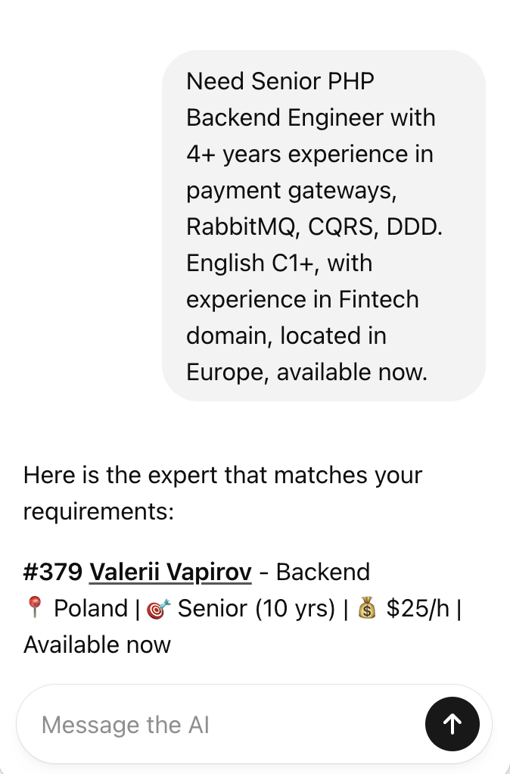
How it works
User describes requirements in plain English, for example, "Need Senior PHP Backend Engineer with 4+ years experience in payment gateways, RabbitMQ, CQRS, DDD. English C1+, available now."
The system applies filters to the expert database and returns matching candidates with the following Actions proposed:
- View expert profiles;
- Get contact information;
- Create proposals with flexible pricing;
- Add experts to proposals;

Slide 5

What makes you special?
Cortance is the fastest way for startups and product teams to hire reliable senior developers without dealing with agencies, recruiters, or freelancer chaos.
We combine AI precision with human vetting to find exactly the developers your team needs - instantly.
Describe what you need → get an precise AI selected 100% suitable developers → onboard in days.
No noise, no mismatch and irrelevant profiles, just talent that fits.

Slide 6

What makes you special?
Cortance delivers three things other hiring models fail at:
🔍 Relevant matches: no noise, no irrelevant CVs, only 100% fits provided by Unique AI Powered Smart Matching System;
⚡ Very fast process : minutes instead of hours or days for receiving a truly fit candidate;
🤝 Reliable senior talent: pre-vetted, verified, accountable candidates;
This is the “triangle” clients keep paying for.

Slide 7
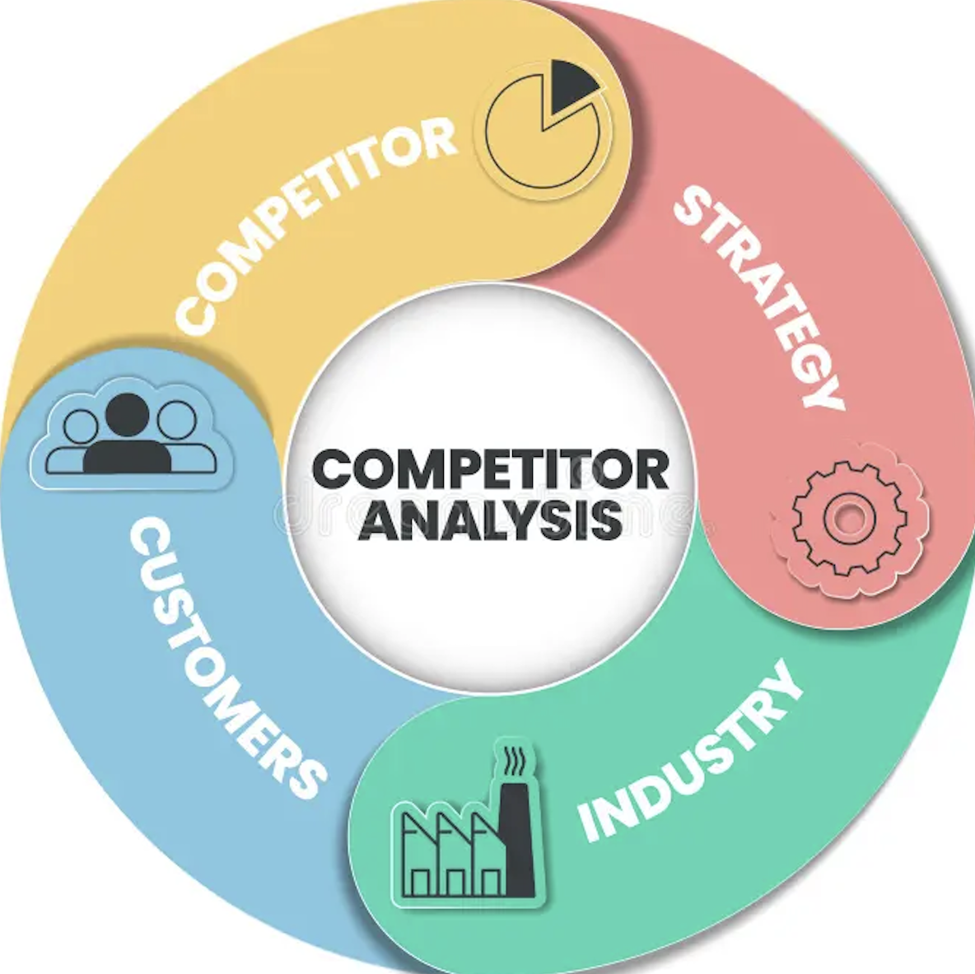
Competition / alternatives
 | Cortance | Proxify | Lemon.io | TopTal
A platform with publicly listed developers | Yes | No | Yes | No
An AI-powered matching system | Yes | No | No | No
An Initial 100% fit personal proposal creation | Yes | No | No | No

Slide 8
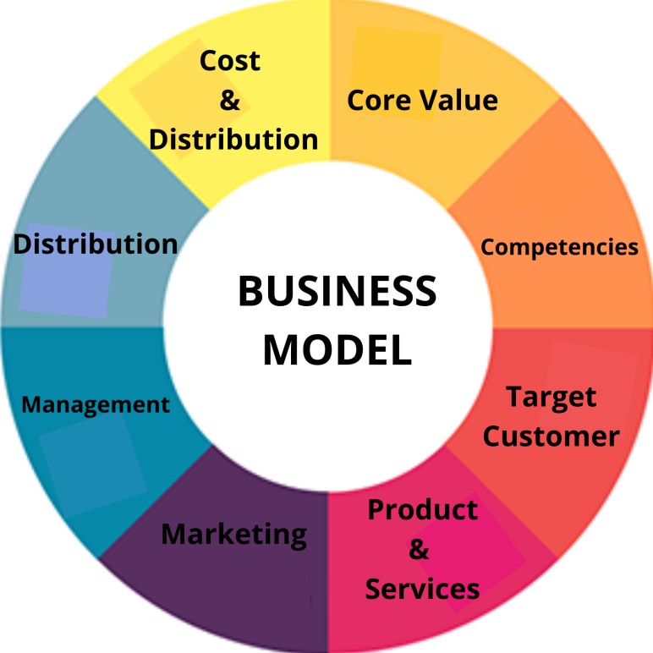
Business model
Talent-as-a-Service (TaaS) with recurring revenue, based on the margin on hours billed.
Cortance charges clients an hourly rate (e.g. $40/h), pays experts a slightly lower rate (e.g. $30/h) and keeps the spread (here: $10/h = 25% margin).
This fits Cortance because we are selling ongoing capacity, not one-off hires.

Slide 9
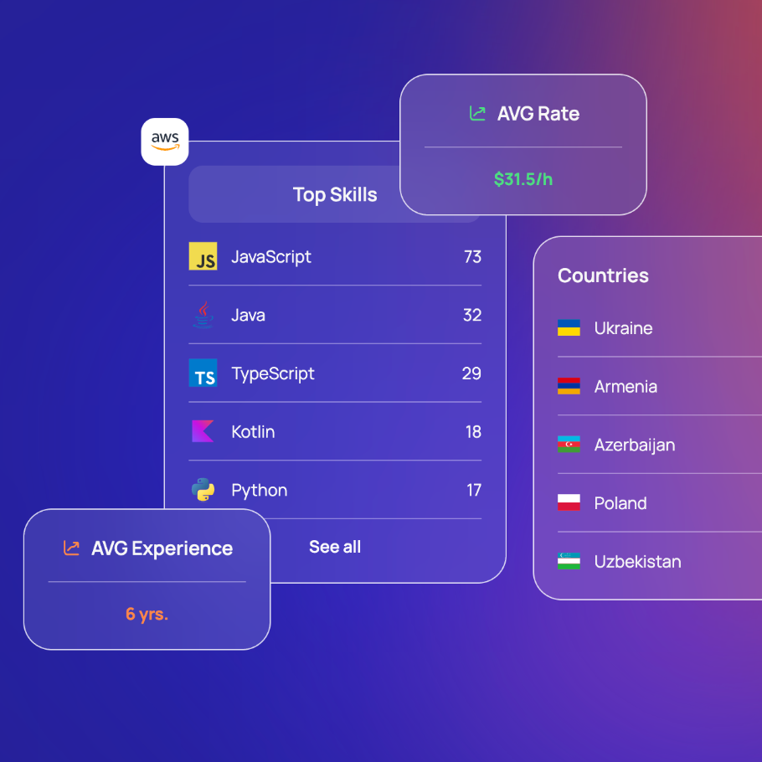
How does Cortance plan to succeed with this business model?
A. By being accurate, faster, more flexible and more reliable than agencies and other platforms.
B. Our main revenue lever isn’t the number of clients, it’s:
How many devs are active × how long they stay × our margin, so to thrive we focuses on:
- Increasing active dev count;
- Fill more seats per client (teams, not just individuals);
- Keeping engagements long;
- Maintaining healthy margins;

Slide 10
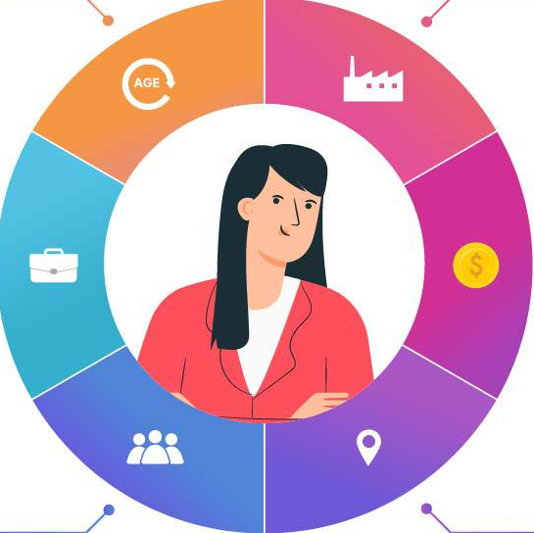
Market potential
Let’s be very precise. These are our top 4 ICP in the market among the Startup and Product companies.
ICP 1 – “The Non-Technical Founders Who Needs a Real Team, Fast”;
ICP 2 – “The Overloaded CTOs Who Needs Capacity.”;
ICP 3 – “Revenue-Driven Leaders in High-Cost Markets”;
ICP 4 – “Product Studios, Venture Builders, and Agencies with Overflow”

Slide 11
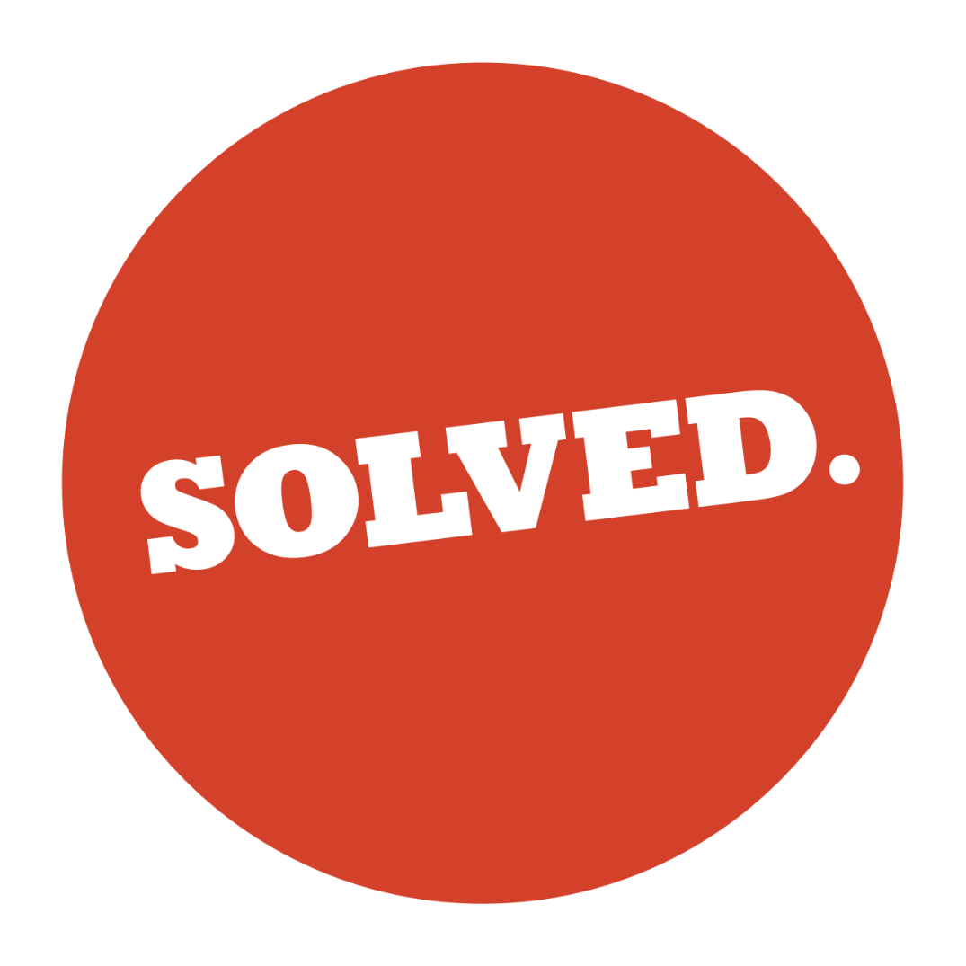
Pains we're sorting out for the mentioned ICPs:
- Can’t close local devs (too expensive, too slow);
- Doesn’t know how to vet technical talent;
- Product roadmap is blocked by hiring;
- Inability to always hire full-time staff for each working wave;
- Need extra capacity quickly, and quality must be high.

Slide 12
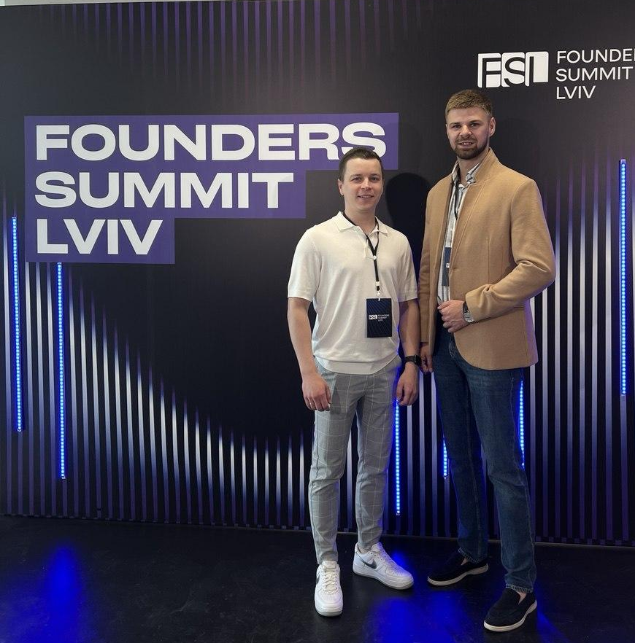
Team
Our C-level structure is standard. We are a team of two co-founders, with me as the CEO and my partner, Alex Korniienko, as the CTO.
Both of us have nearly 10 years of experience in the IT industry. I`ve been working in sales and business development, while Alex specialises in development, leading projects and teams of varying complexity. Both of us have worked closely with clients, which has enabled us to understand the issues and market factors involved in sourcing and supplying the right tech candidates from both management and technical levels.
Combining our experience has allowed us to create a well-structured, centralised ecosystem that addresses current market needs, aligns with the latest technologies and approaches, and, importantly, addresses hurdles in global tech talent hirings.

Slide 13

What you need
To achieve our goal for 2026:
– 8–12 paying startup/product clients;
– 12–21 active billed developers;
We’re raising €100k specifically for Lead Generation, GTM & Sales, as well as the tools needed to support them.
Product, operations, and delivery are managed efficiently by the founding team, and current cash flow covers these areas.

Slide 14
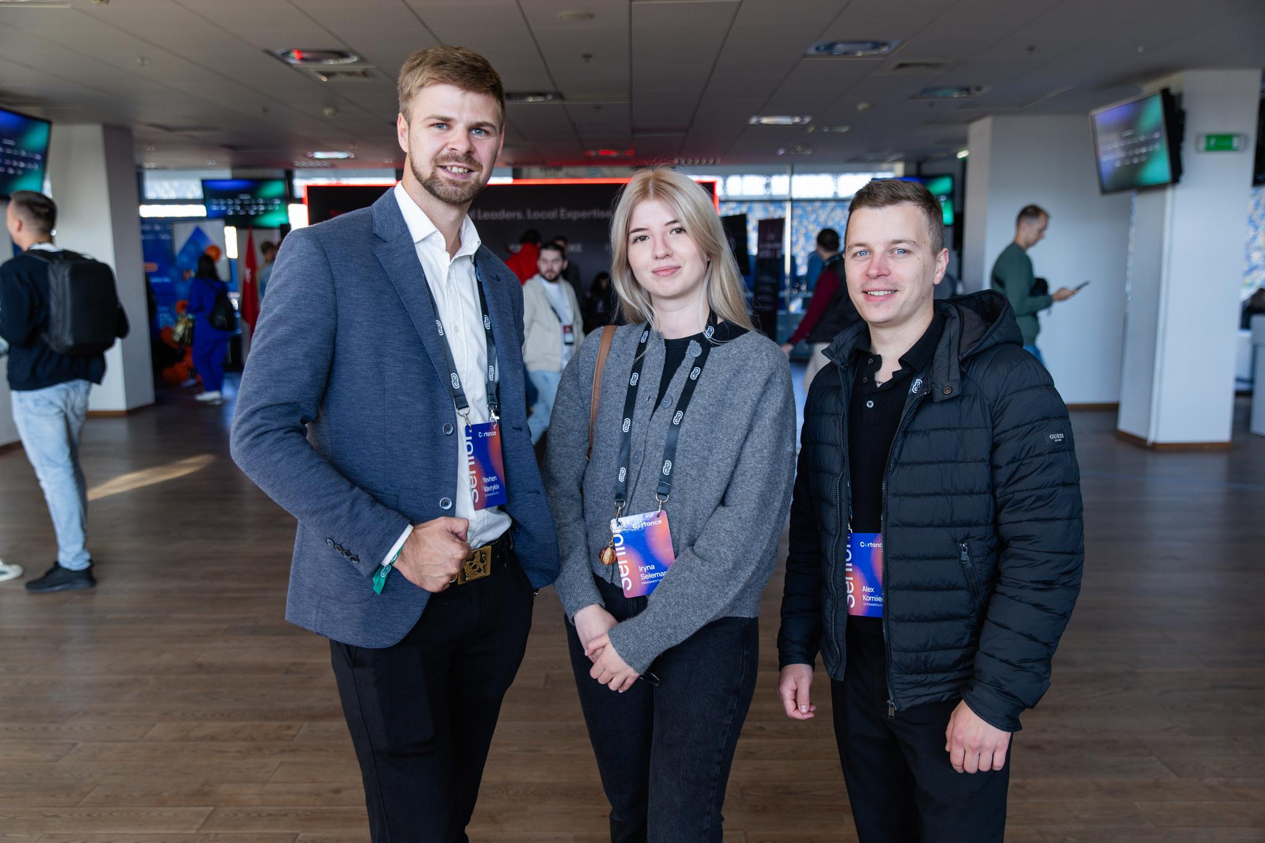
Contacts
Yevhen Vavrykiv, CEO & Co-founder of Cortance
Email:
yevhen.vavrykiv@cortance.com
LinkedIn:
https://www.linkedin.com/in/yevhen-vavrykiv/
Oleksandr Korniienko, CTO & Co-founder of Cortance
Email:
alex.korniienko@cortance.com
LinkedIn:
https://www.linkedin.com/in/alex-korniienko/
Company website:
https://cortance.com
Book a meeting link:
https://calendly.com/cortance/45min
Company website:
https://cortance.com
Book a meeting link:
https://calendly.com/cortance/45min

